Slide 1




PwC Retail Solution Set:
Integrating the Web Customer Channel

Slide 2
Expanding into the Internet: Integration Challenges
Lack of a shared customer repository
  Do customers that shop more that one channel spend more ?
  How many customers have migrated across channels? Which segments?
Cross-channel customer touchpoints not tracked
  How are e-mail and direct mail campaigns coordinated?
  Are customer segments shared across all channels?
Readily available internet behavior - i.e. clickstream - either not tracked, or worse, tracked but not used to improve other areas
  Does the internet visitor shop the same way as a store visitor?
  What is selling better - static or dynamically-merchandised pages?
  Why do customers abandon purchases?
Gold mine of purchase history not leveraged for internet channel
  Is purchase history from one channel used to drive up-sell and cross-sell opportunities in the other channel?

Slide 3
Integration Challenges (con’t)
Customer profiles not leveraged on-line
  Is RFM data from one channel be used to merchandise real-time to the individual on the Internet channel?
  Are there business rules in-place to more effectively merchandise to specific segments?
Increased time to market for publishing to Internet channel
  How is content routed and approved for publishing?
  Is IT backlogged with manual updates to web pages?
Lack of supplier integration
  How is content requested and/or received from suppliers?
Not Presenting one face to the Customer (separate systems, separate processes)
  Can Internet-purchased items be returned to the physical store?
  Can I cost-effectively expand assortments in the physical store by providing Internet kiosks?
  Are store managers incented to drive business to other channels?

Slide 4
Areas of Integration for Web Channel
Content Management (Get to Market Faster)
eMerchandising (Use New Tools to Merchandise Effectively)
Business Rules (Personalize Based on the Customer or Product)
Campaign Management (Segment and Increase Response Rates)
Suggestive Selling (Increase Revenue w/ Up-Sell & Cross-Sell)
Clickstream Analysis (Understand Customer Behavior)
Metrics and Measures (Track Your Progress)
Most retailers do some of these at a high-level
Many do some of these at an in-depth level
A few do all of them
The best few have them integrated

Slide 5
Content Management (Get to Market Faster)
Combine content into single repository and establish process workflow for copy, images, marketing, etc. Manage the content at the enterprise level instead of in individual silos to establish consistent branding across the organization
Decrease costs associated with content creation by providing the ability to electronically request and receive content from suppliers
Assign and automatically route tasks directly to specific users for work and approval
Establish effective and expiration dates to manage the content on the site
Integrate with eMerchandising for streamlined publishing process

Slide 6
Content Management (Get to Market Faster)
Days required to add a new product/service to the Internet (includes content creation)
<=1
5
7
10
Client Y
Average
Number of technical resources involved in making a site content change (e.g., image ‘swap’)
0
1
2
3
4
5
Client Y
Average
Percentage of content that is used across multiple marketing and sales channels
0
20
40
60
80
100
Average
Client Y

Slide 7
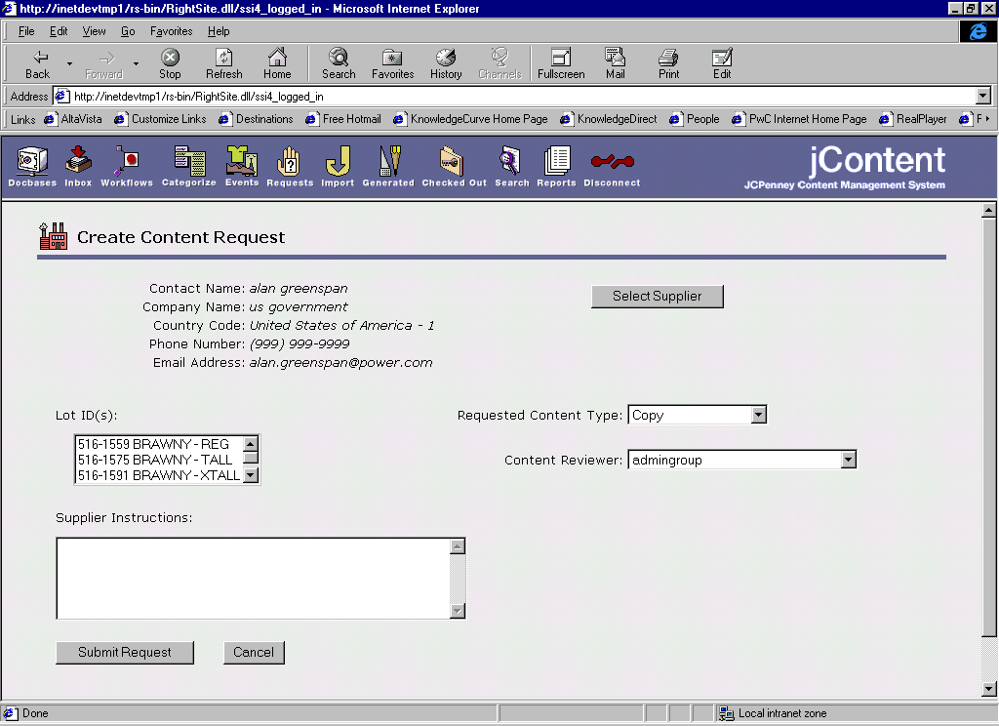
Content Management (Get to Market Faster)
Client X
Example:
Request Content from
a Supplier
Notes:
12

Slide 8
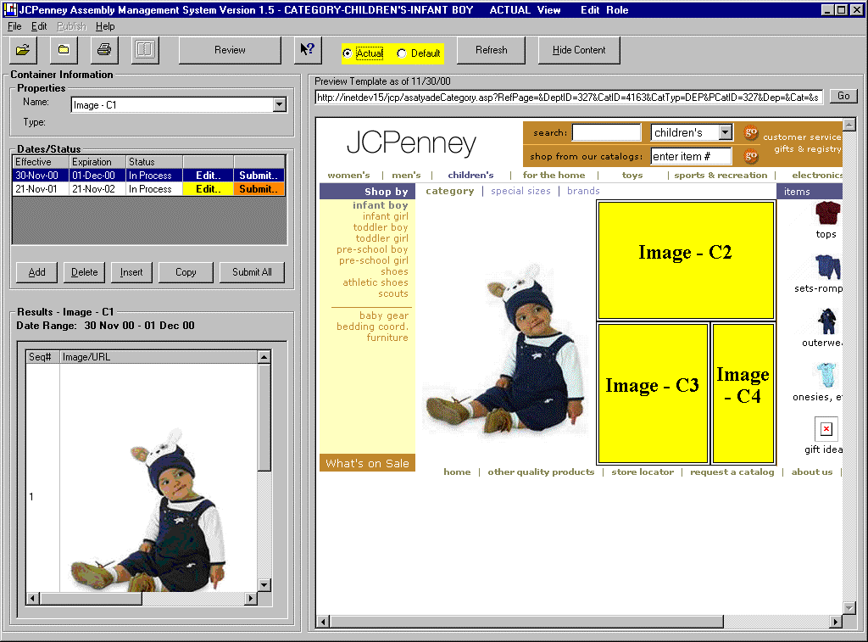
eMerchandising (Use New Tools to Merchandise Effectively)
Leverage the Content Management system by automating publishing
Workflow routes site pages through an approval and publishing process
Eliminate the need for IT to generate and publish pages - Merchants own the pages
Content can be updated daily and automatically published
Integrate with Business Rules and Clickstream - Make ‘C’ Merchants ‘A’ Merchants

Slide 9
Business Rules (Personalize based on the Customer or Product)
Standardize the real-time merchandising process to increase sales
Increasing Automation
Increased $$ Potential
Real-time content updates are managed automatically based on variable input (e.g. RFM values, Strength of Relationship, Inventory Levels, Margin, etc.)
Micro-focused “Dynamic” Rules
Mass Market
“Static” Rules
Availability of data
& clear definition of the rule
Process for updating content is increasingly standardized as the organization agrees to key criteria and as information delivery is automated. Complete rules automation is not yet feasible, as subjective criteria enter into the decision-making process
Content driven by intuition & exogenous data
In this stage, content updates are managed by each individual’s knowledge and perception. Criteria for taking action are clouded by a limited fact base
Organizational readiness

Slide 10
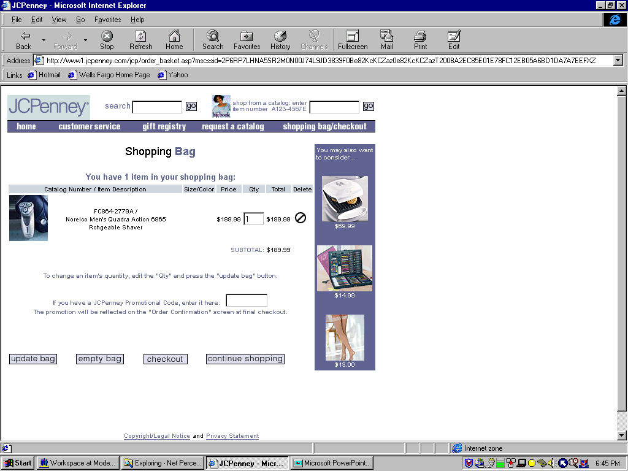
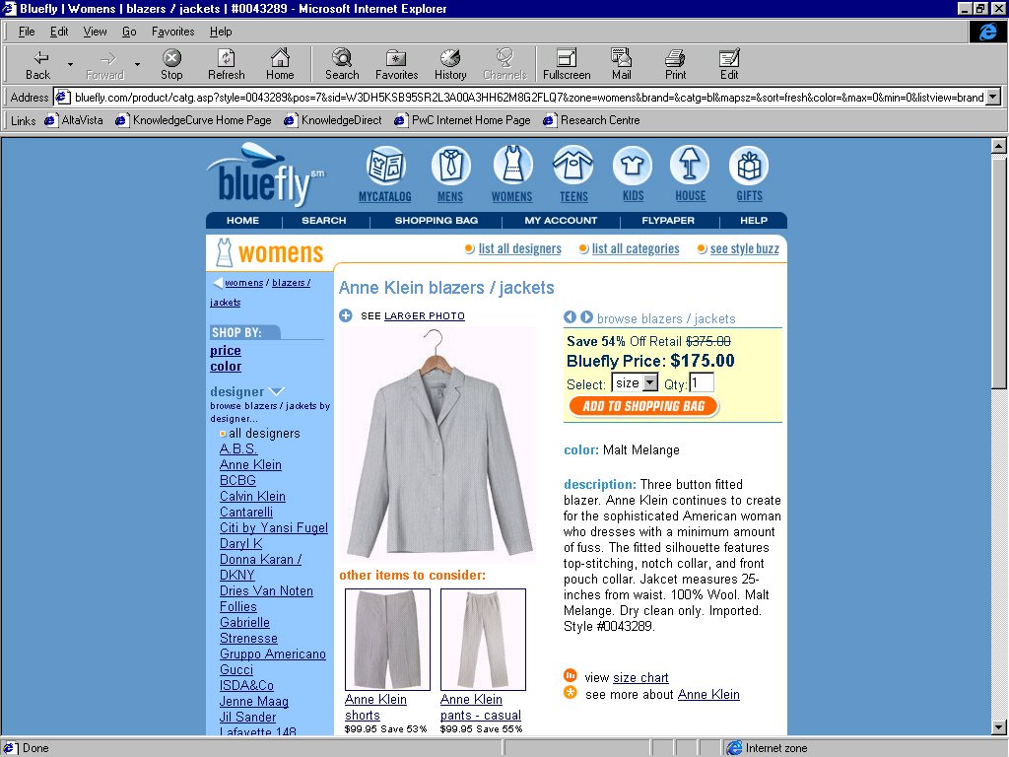
Suggestive Selling (Increase Revenue w/ Up-Sell or Cross-Sell)
Real-time up-selling and cross-selling should be automated and used to substantially increase basket size
Quantifiable business case, benefits easily tracked
Reactive (analysis against shopping cart) is good. Pro-active recommendations are better.
Compare against effectiveness for statically merchandised pages to determine optimal levels of Business Rules automation
Integrate real-time with Legacy Purchasing and Inventory Systems and Clickstream Data to provide sophisticated recommendations not just based on product affinities, but dynamic updates based on like-customer purchases, inventory levels, demographics, and customer navigation

Slide 11
Campaign Management (Segment and Increase Response Rates)
Establish the processes and tools to automate the circle of marketing and structure the approach for planning, executing, tracking, and analyzing campaigns
Quantifiable business case, benefits easily tracked
Many retailers Plan and Execute e-mail campaigns, a few attempt to effectively segment the customer base, fewer incorporate the learning from the last campaign into the next campaign, and even fewer integrate with the other channels for a coordinated customer touchpoint
Integrate with Clickstream Analysis and Business Rules to understand customer behavior and increase the campaign response rate
Planning
Analysis
Execution
Tracking

Slide 12
Clickstream Analysis (Understand Customer Behavior)
How many users responded the e-mail campaign we sent last week? What was the average basket size?
Did high RFM visitors purchase product when we showed them an on-line promotion?
At what point do users abandon the site?
At what time of day do the majority of users hit the site? Where are they from? Should we merchandise differently based on time of day?
How long is the average customer on a particular page? Who was on on a product page more than 4 minutes but didn’t purchase the item (we should send them an e-mail with a 10% discount if they log back on and buy it)
How many customers purchased product that was manually merchandised vs. automatically merchandised based on a business rule? What was the average basket size for each?
Integrate with Campaign Management, Business Rules, and eMerchandising to understand promotion effectiveness and customer behavior
Demographics
Click From
ClickStream
Customer
Behavior
Promotions

Slide 13
Metrics and Measures (Track Your Progress)
Get a management dashboard in-place. Start simple with a handful of key metrics, and gradually increase the level of sophistication. Trend progress over time. Use the results to improve your e-mail campaigns. Improve merchandising on the site. Simplify the navigation. Track yourself against the competition. Know where to focus.
Number Of Existing Customers
Unique Visits
Average Visits Per Customer Per Year
Total Number of Visitors
Number Of Households
Look-to-buy Ratio
Average order size
Total Revenues per Customer (wallet size)
Dollar/Unit Sales
Profit Margin
Sales and profits by home and syndicated sites
Number Of Orders
Site Inventory Count
Lot Inventory Count
Average Number of Days From Order To Ship
High Volume Times
Clicks Per Day, Week, Etc.
Page Views
Web Site Performance (e.g., Speed)
Image Inventory Count
Number of new/changed site pages

Slide 14
Metrics and Measures (Track Your Progress)
Top Internet Retail Sites have Conversion (Look-to-Buy) Ratios of btw. 8-10%. What’s yours? How does this week compare to the same week last year?
Research groups say 2/3 of shoppers abandon their carts before checkout. How many visitors fail to checkout on your site? Is this number improving, or is the situation getting worse? Where on the site do they give up?
You spent $2,500,000 in on-line and off-line advertising this year. How many people that saw the ads visited the site? How many bought? How much did they buy compared to the average customer?
The lead merchandiser updated several of the product pages last week. Did sales of the products increase? Did the abandon rate for those pages decrease? Was a dynamic business rule used, or did the merchant use a static presentation?

Slide 15
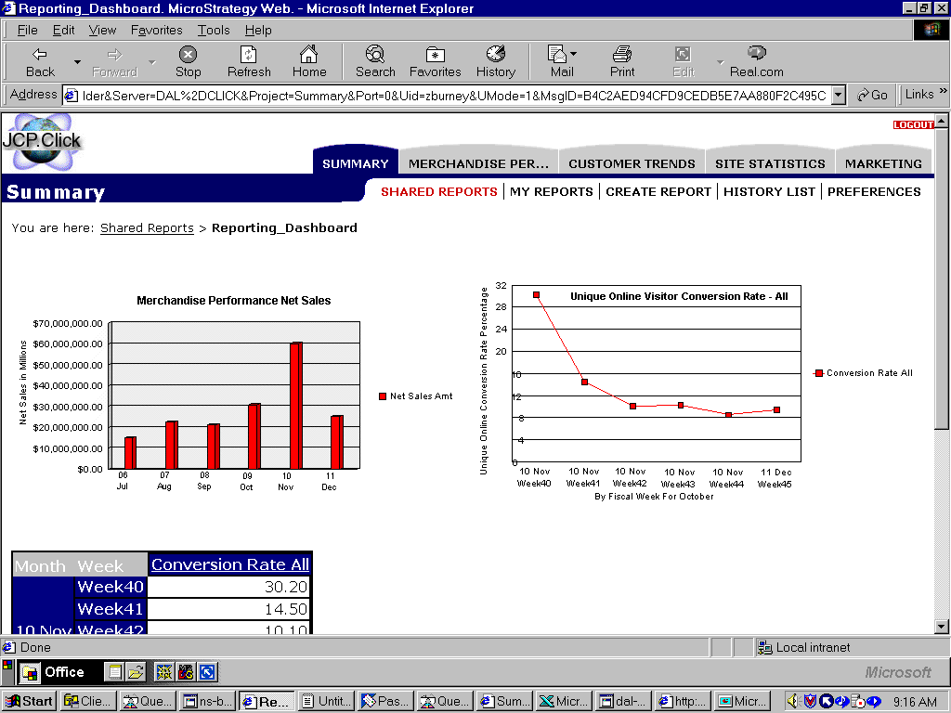
Management Dashboard - Summary

Slide 16


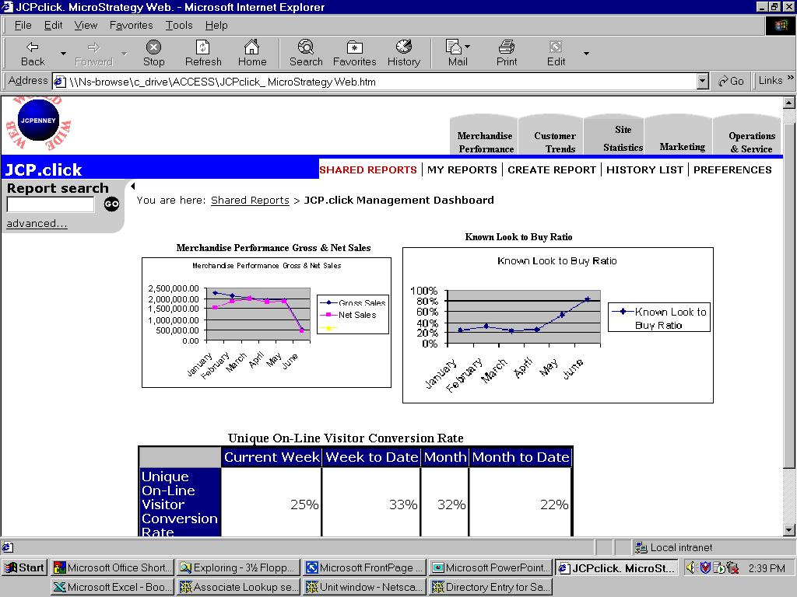
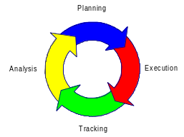
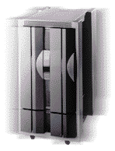

Web Channel Integrated Environment
Suppliers
Print Catalog
Metrics & Measures
Campaign Management
Demographics
Click From
ClickStream
Content
Management
Customer
Behavior
Promotions
Internet Store
Clickstream
eMerchandising
Suggestive Selling
Order Management and Fulfillment Systems
Dynamic
Static
Customer Database
eCare
Intuitive
Business Rules

Slide 17
FastPath Analysis
Develop 18 month Roadmap (to be revisited every 6)
Prioritize Opportunities based on Business Benefit
Map Current Capabilities to Potential Future State
Highlight 2-3 Revenue-Impact Areas
  Most rapid return on investment with lowest implementation complexity
Approximately 6 FTEs; 4 weeks

Slide 18
PwC Retail Solution Set:
Integrating the Web Customer Channel

Slide 19
Target Audience
An Established Brick & Mortar Retailer
  With a legacy infrastructure (e.g. Order Processing, Fulfillment, Customer database) that does not make sense to abandon
Who Understands the Reasons for Expanding into the Internet Channel
  Understands the synergies and effectiveness of an integrated multi-channel operation
  Even better if Retailer has an established Catalog Customer Channel due to catalog infrastructure that can be (better) integrated with the Web Channel
Who Recognizes that the Goal of Doing Business over the Internet is to Increase Revenue
  Market Share and Market Capitalization are By-Products of Making Money, not the other way around

Slide 20
Expanding into the Internet: What Doesn’t Work
Spending big $$$ on Internet brand marketing. It doesn’t necessarily translate into success. Focus spending on areas that will impact the bottom line shorter-term.
Separating Internet from the other channels. It does open the door for energetic attitudes and new approaches to work. But it also means reinventing what the traditional company already does well, such as procurement, order taking, and fulfillment (was there a reason the company was in-business before the internet, or was it 30 years of extraordinarily good luck?)
“One stop” software solutions. When everyone’s business is run the same way and has the same infrastructure this principle should be revisited. Use the established systems in-place - integrate the weak areas with best-of-breed solutions.
Complexity. Long cycles trying to create unique on-line “emotional experiences” usually fail. Keep it simple. Focus on translating the brand. Allow customers to quickly log in, buy product, and check-out successfully - that will be a positive emotional experience.

Slide 21
Four Success Criteria
Leverage What You Have (integration is difficult, but worth it)
Speed and Simplicity (get it done in 6 months or less, iterate)
Track Impact to Bottom-line (be revenue focused)
Understand New Capabilities (finally you can track customer behavior)

Slide 22
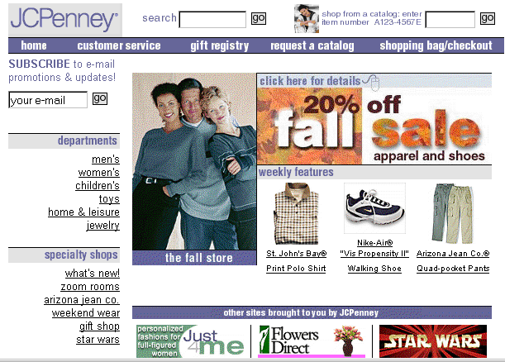
Moving to Enterprise Content Management
Catalog
Publishing
Web
Publishing
Retail
Publishing
...
Content
Silos
IMS
Web
Content
Management
ZPics
...
VS.
Catalog
Publishing
Web
Publishing
Retail
Publishing
...
Enterprise Content
Management
Enterprise Content Management
CD-ROM
Email
Business Partners,
Service Providers
Suppliers

Slide 23
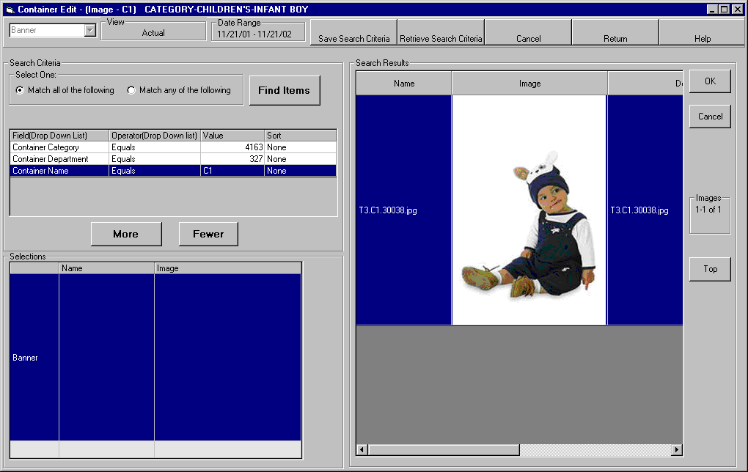
eMerchandising — Container Edit Window

Slide 24
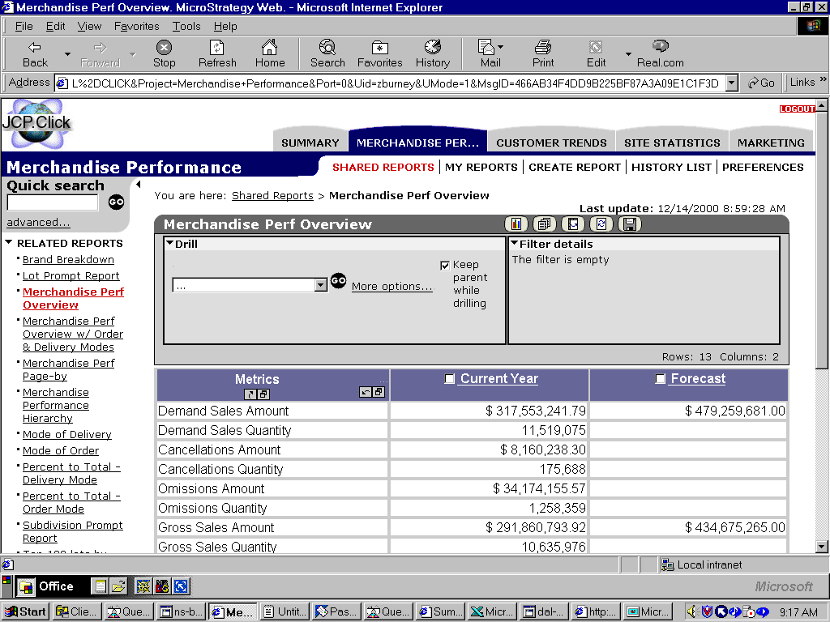
Management Dashboard - Financials

Slide 25
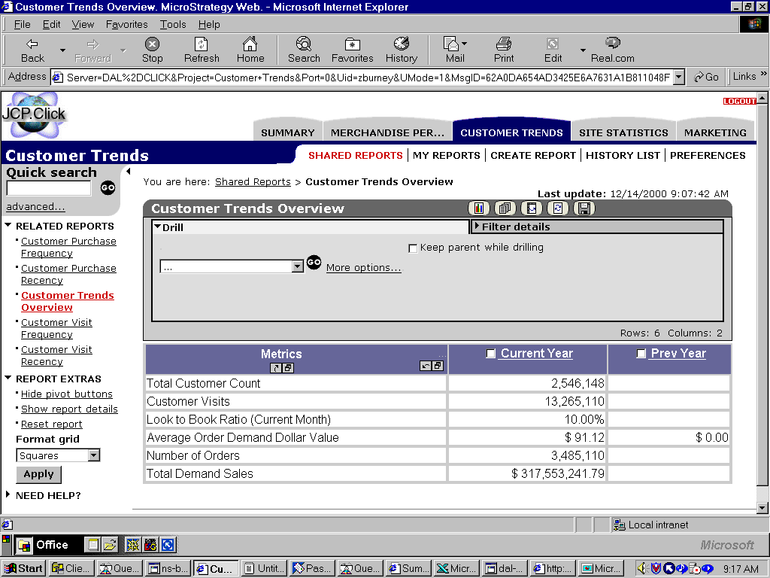
Management Dashboard - Customer Trends

Slide 26
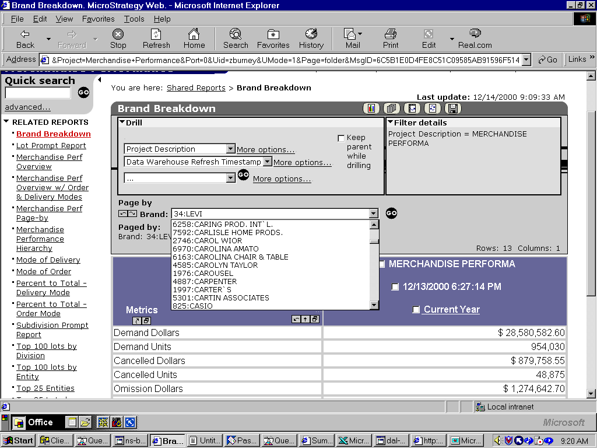
Management Dashboard - Brand Breakdown

Slide 27
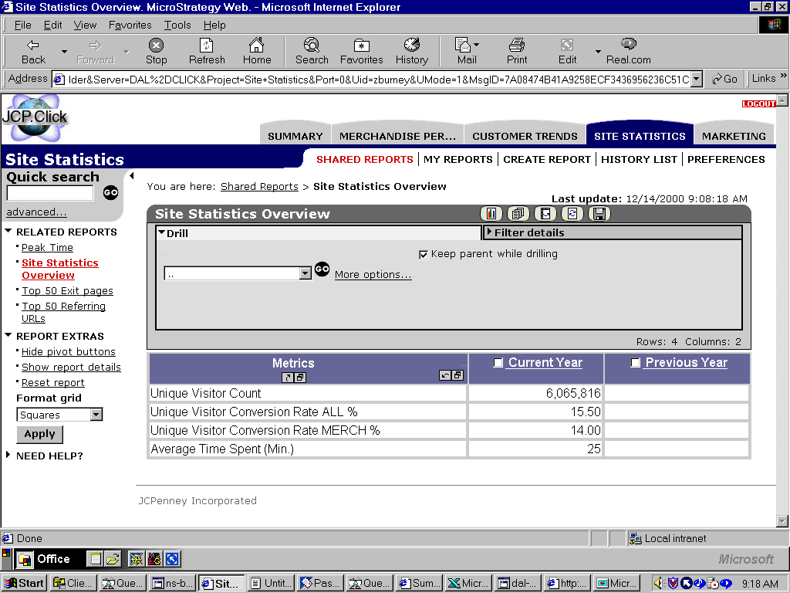
Management Dashboard - Site Statistics

